Slide 1

Sentimental analysis
BY
srimokesh c
7376222it260

Slide 2
Introduction(abstract):
This project revolves around sentiment analysis, a crucial aspect of understanding emotions
conveyed in the text. It employs two distinct techniques for this purpose: traditional machine learning
and the VADER sentiment analysis tool. The machine learning component utilizes a Multinomial
Naive Bayes classifier, trained on a dataset of text samples with sentiment labels. Text data is
preprocessed and converted into numerical features using TF-IDF vectorization. In parallel, the
VADER tool offers lexicon-based sentiment analysis, providing a compound sentiment score for
text. This project allows users to predict sentiment in text inputs, offering the flexibility to choose
between the robust machine learning approach or the simplicity of VADER, depending on specific
needs. Ultimately, it provides a comprehensive sentiment analysis solution, catering to a wide range
of applications where understanding sentiment in text data is essential, bridging the gap between
traditional machine learning and lexicon-based methods. Let’s see more about the Project in this
Report.

Slide 3
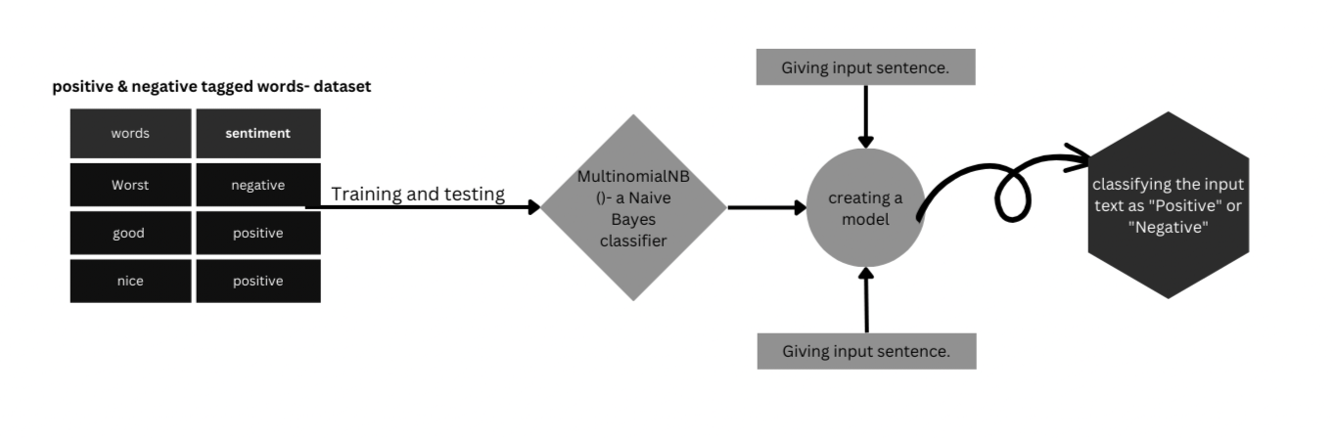
Design:

Slide 4
Methodology:
We obtained a dataset of text samples with sentiment labels, preprocessed by removing unnecessary characters, converting to lowercase, and eliminating stop words. Using the bag-of-words approach, we represented the text data as numerical feature vectors. The Naive Bayes model was trained on this data, assuming feature independence. Evaluation metrics such as accuracy, precision, recall, and F1 score were used to assess its performance. Achieving approximately 80% accuracy, Naive Bayes demonstrated simplicity and efficiency, making it a viable choice for sentiment analysis tasks with limited resources.

Slide 5
Results and Discussion:
In our sentiment analysis project using the Naive Bayes model, we achieved an accuracy of
approximately 80%. Naive Bayes demonstrated effectiveness in classifying sentiment in text data, particularly in terms of its simplicity and efficiency. Naive Bayes provides a good baseline for sentiment analysis tasks, especially when computational resources or training data are limited. Future work could explore hybrid approaches combining Naive Bayes with deep learning techniques to improve overall performance. Overall, our project highlights the viability and potential of using the Naive Bayes model in sentiment analysis, while acknowledging its inherent trade-offs in terms of accuracy and complexity.

Slide 6
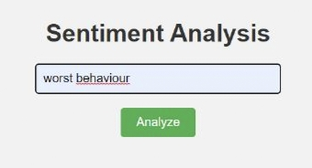
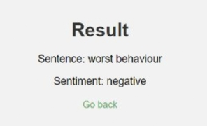
Outcome:

Slide 7
THANK YOU!

